Slide 1
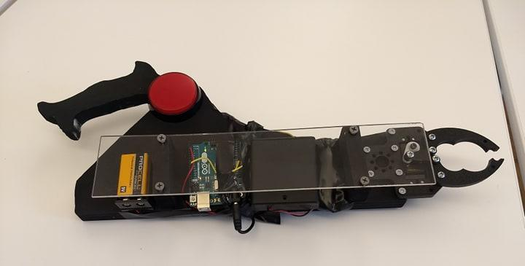
Robotic Hand
iDesign Studio Final Project
By Amna Shahid

Slide 2
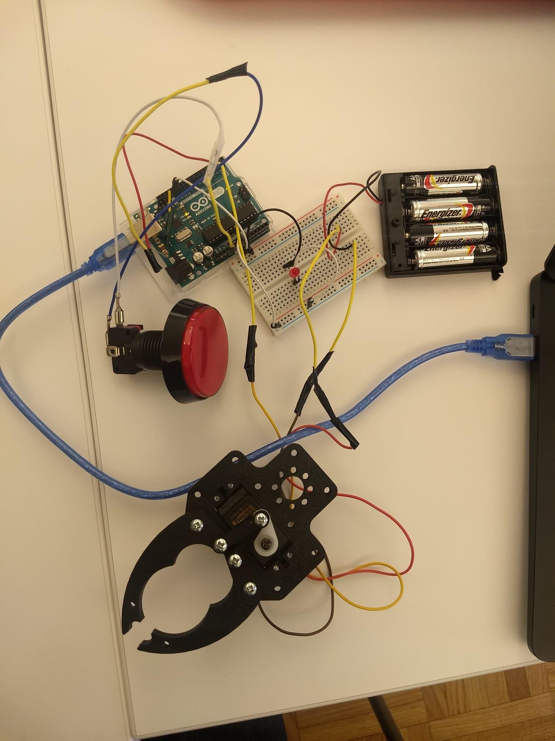
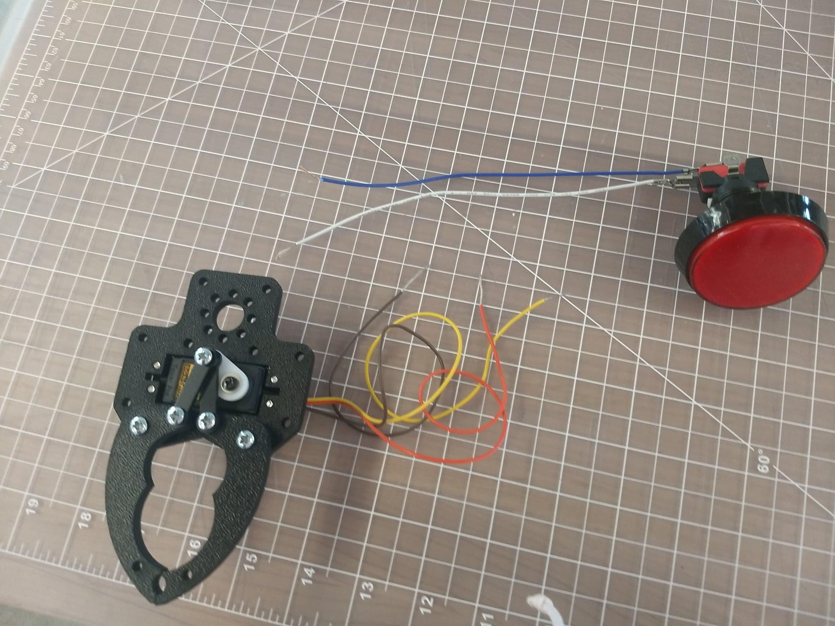
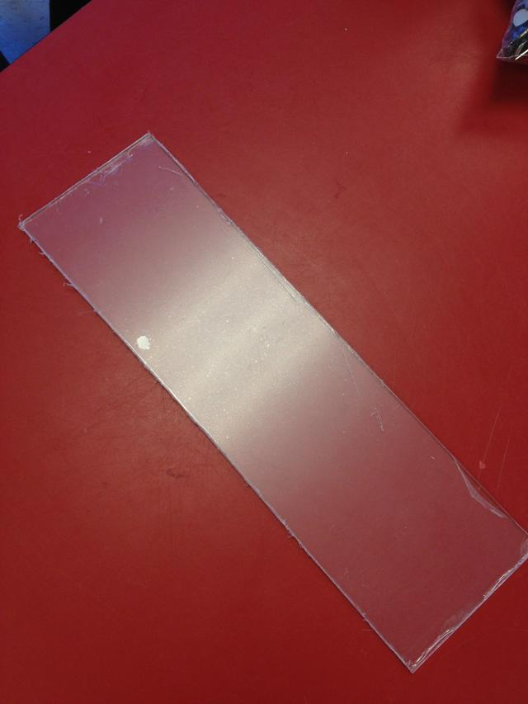
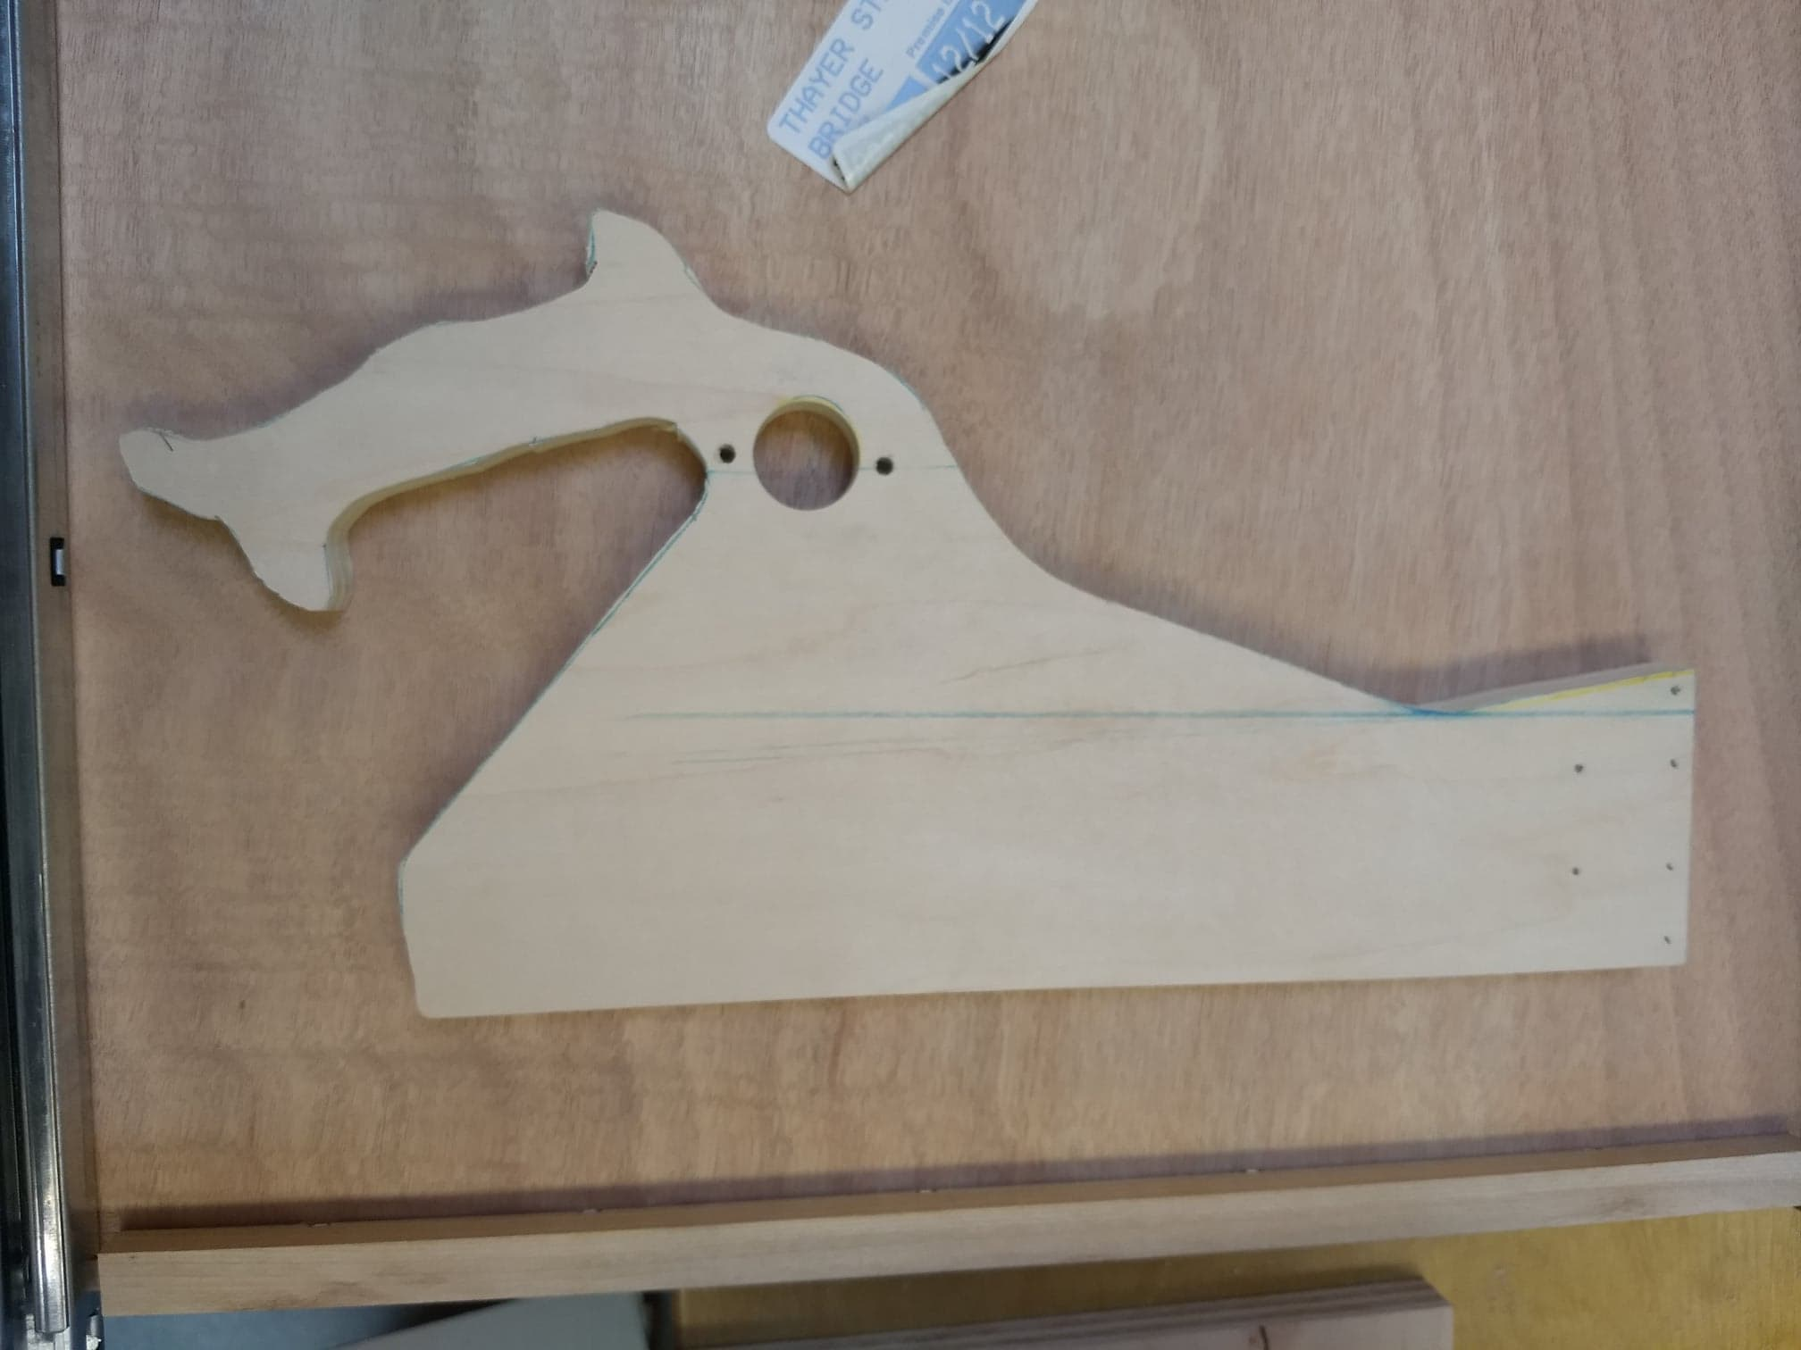
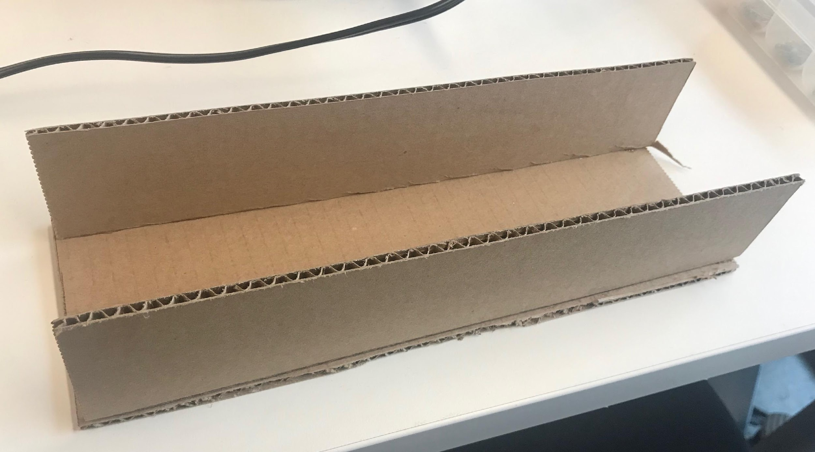
Equipment Used

Slide 3
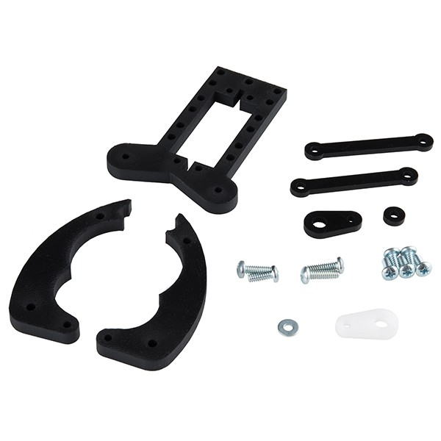
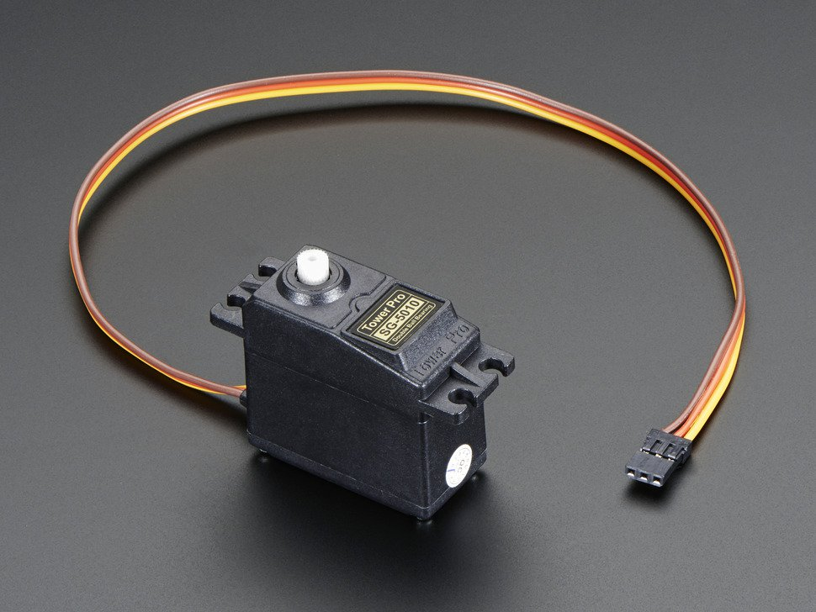
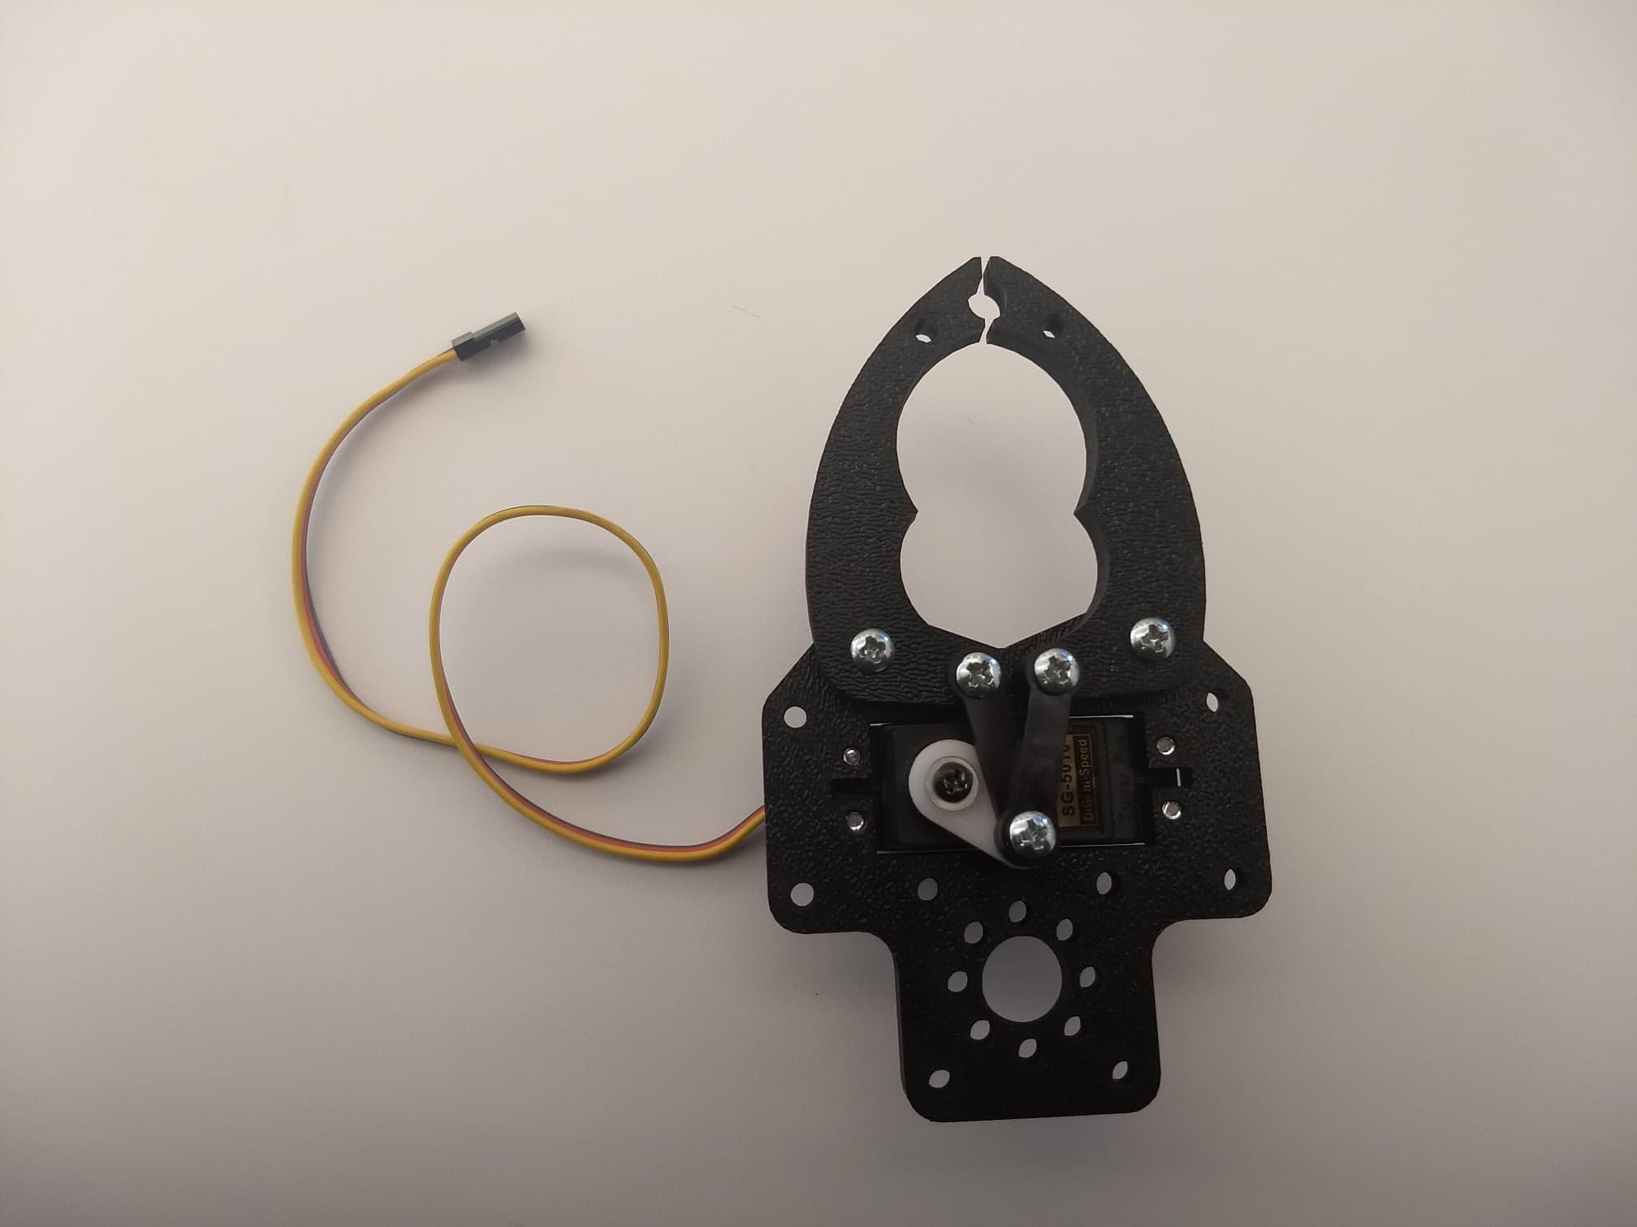
Week 1
Assembled the parts of the robotic gripper together
Attached a servo to it
The servo is the motor which provides power to make the gripper move

Slide 4
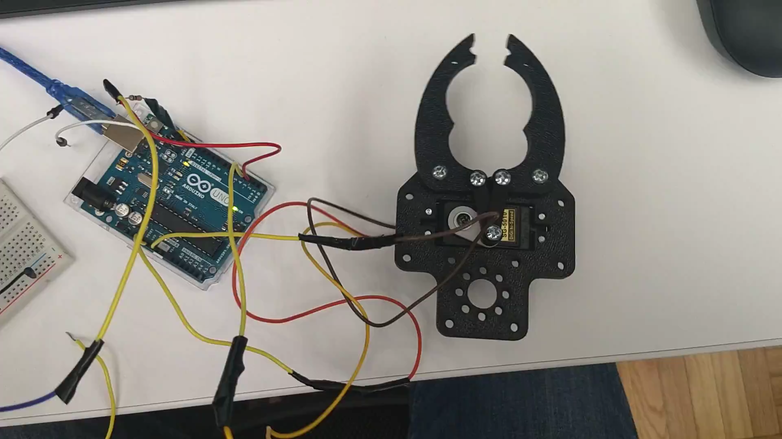
Week 2
Programmed the robotic gripper using Arduino Uno
and a breadboard.

Slide 5
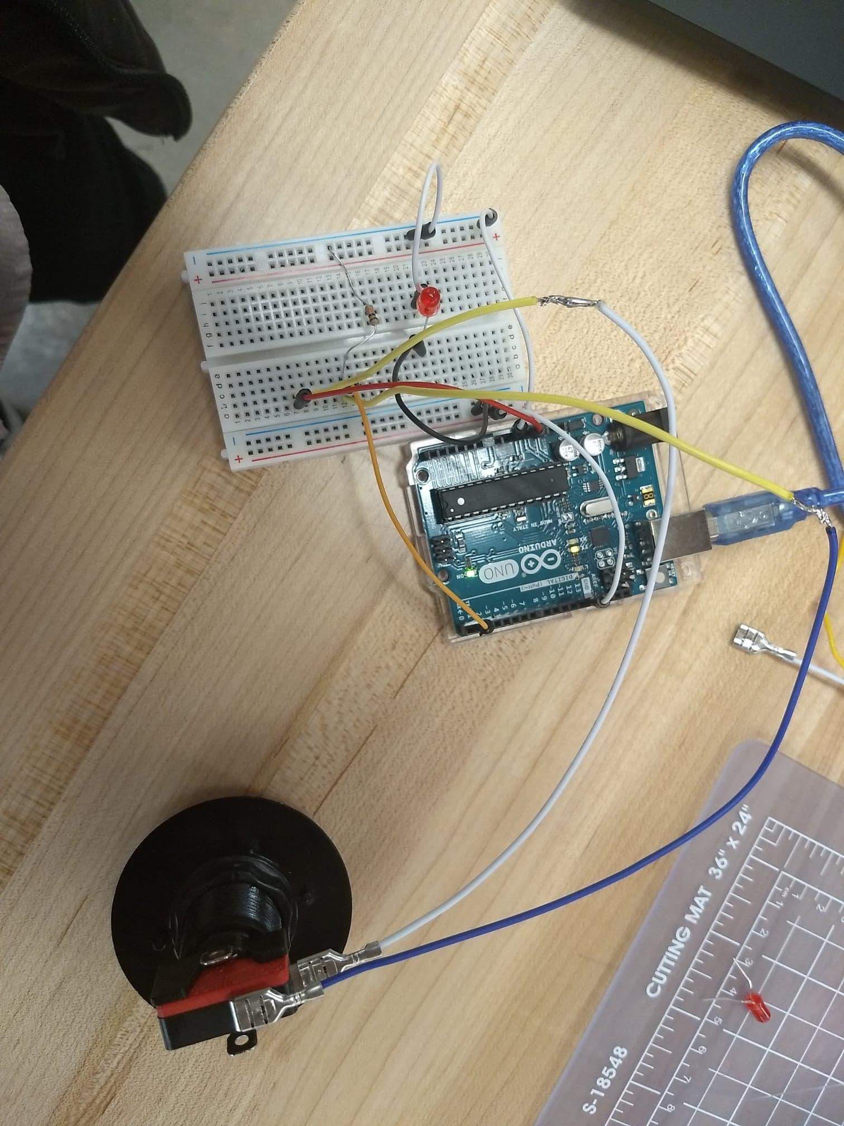
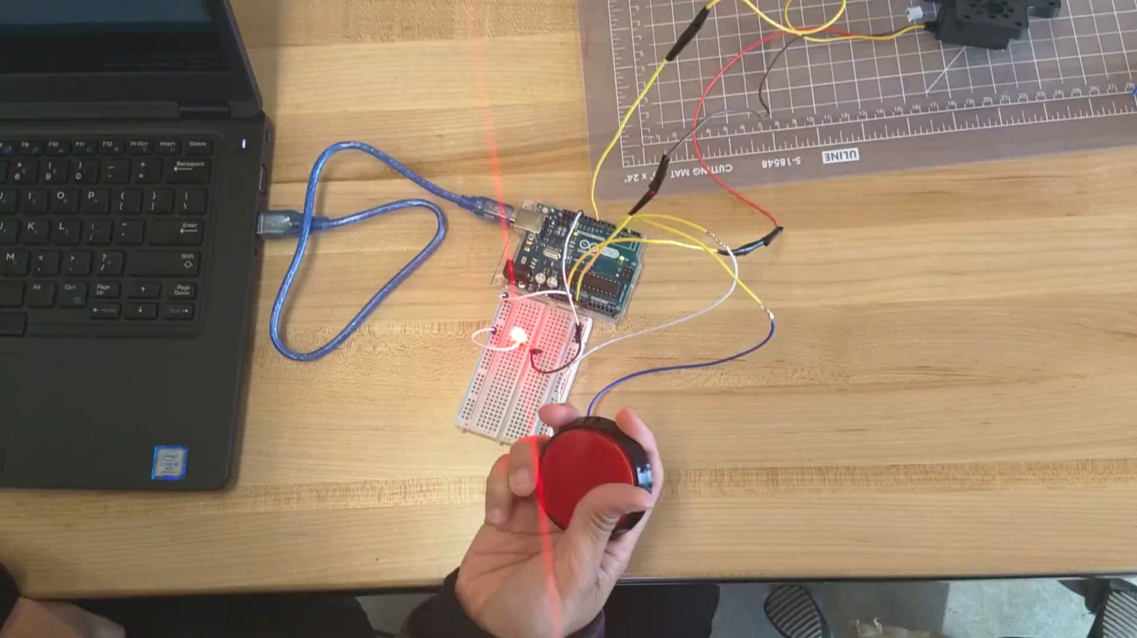
Week 3
Programmed the button separately with the Arduino uno and breadboard
The goal was to make it work as an on off switch for an LED light
This would enable for the button to be used as a switch to open and close the claw of the robotic gripper

Slide 6
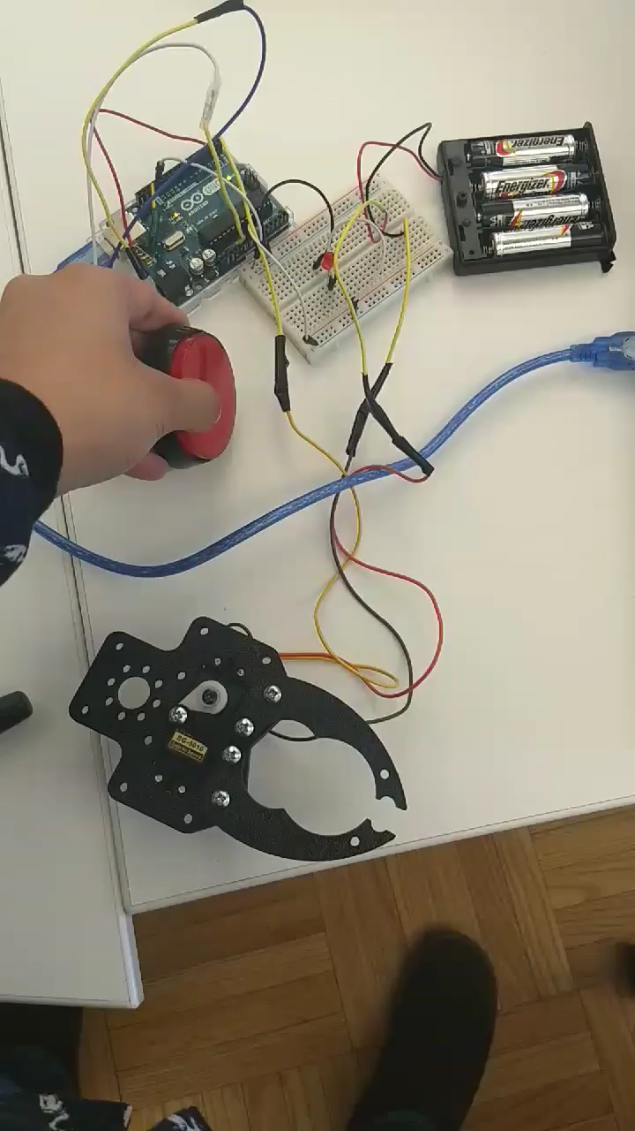
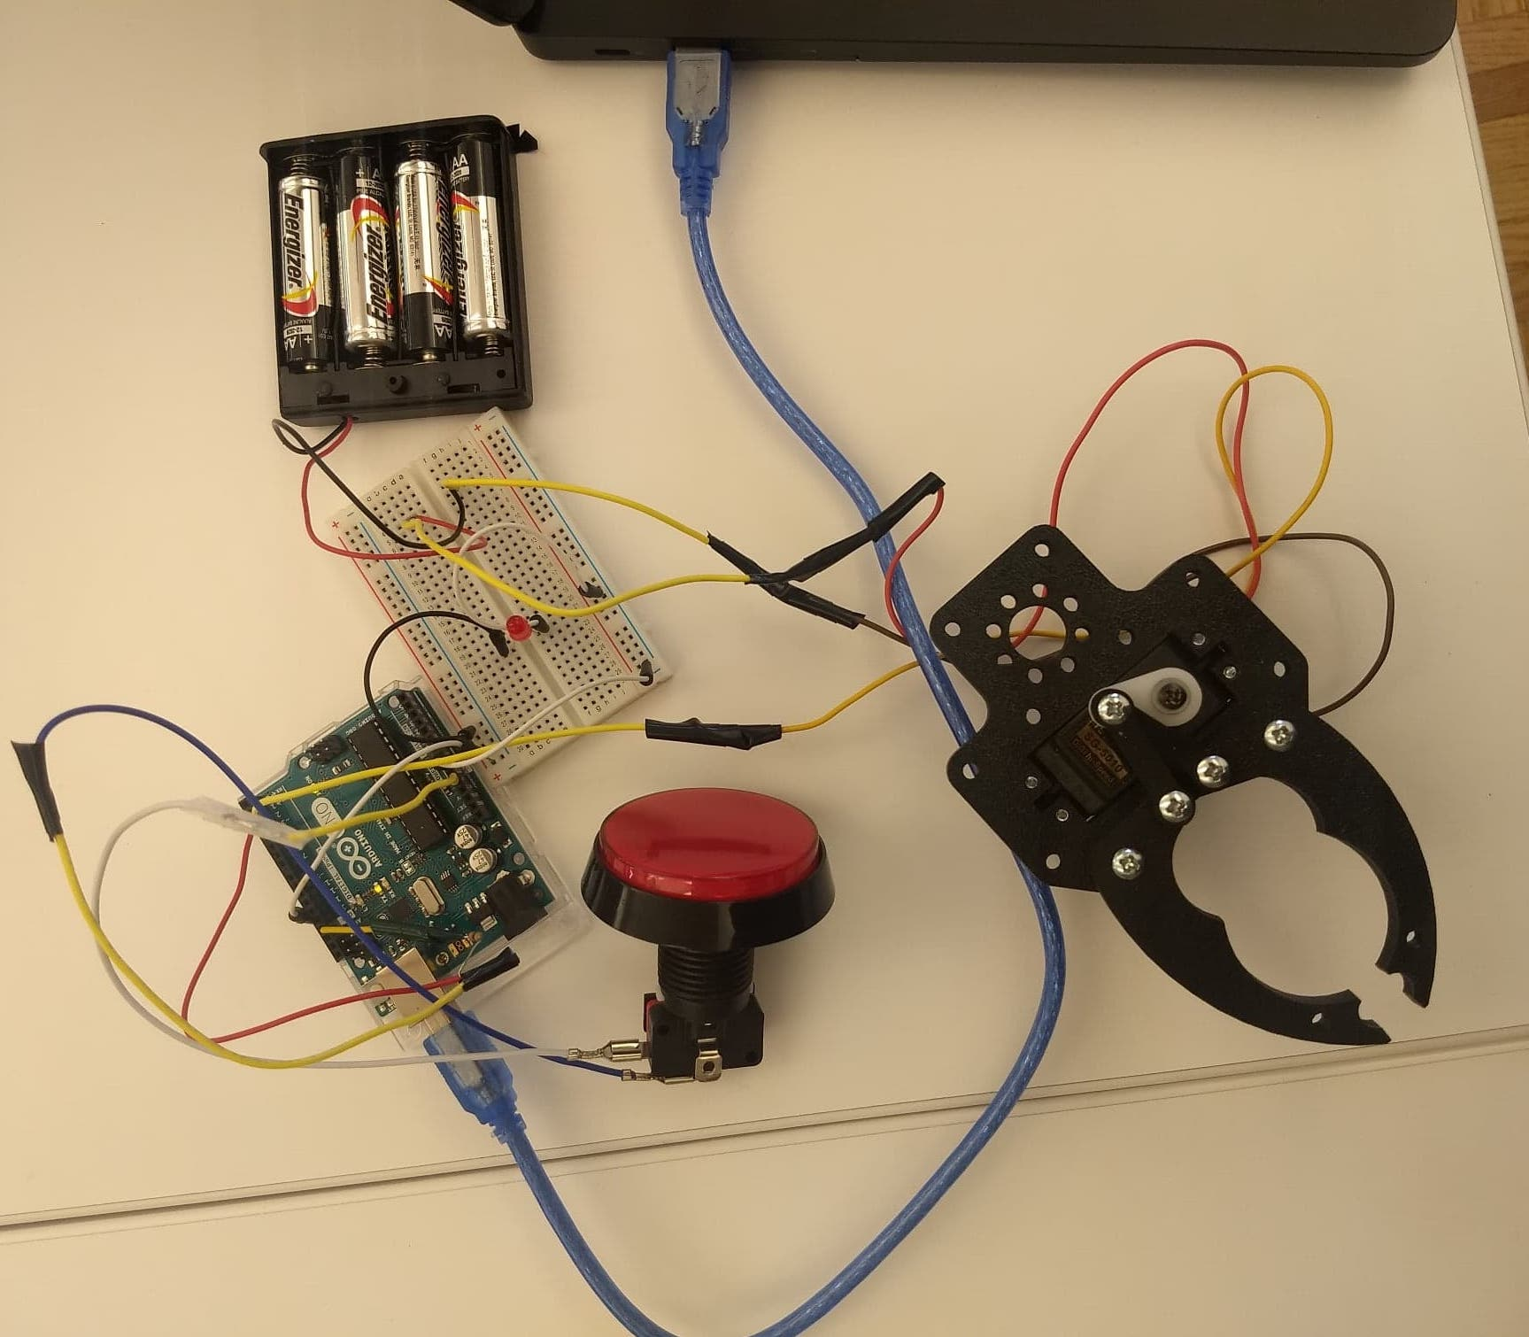
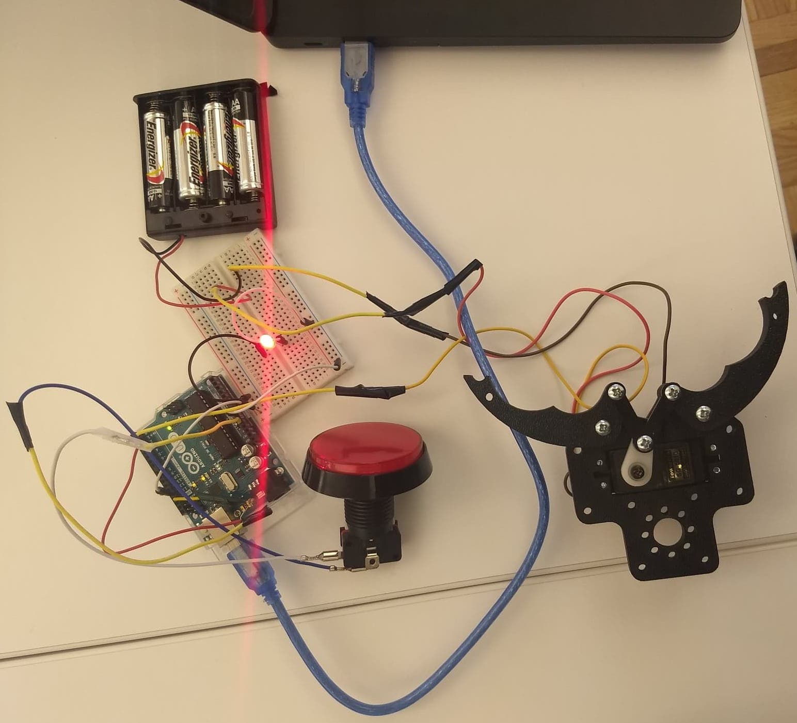
Week 4
Programmed the robotic gripper, button and an LED light together
An LED was used at first as a test to make sure the code was working

Slide 7
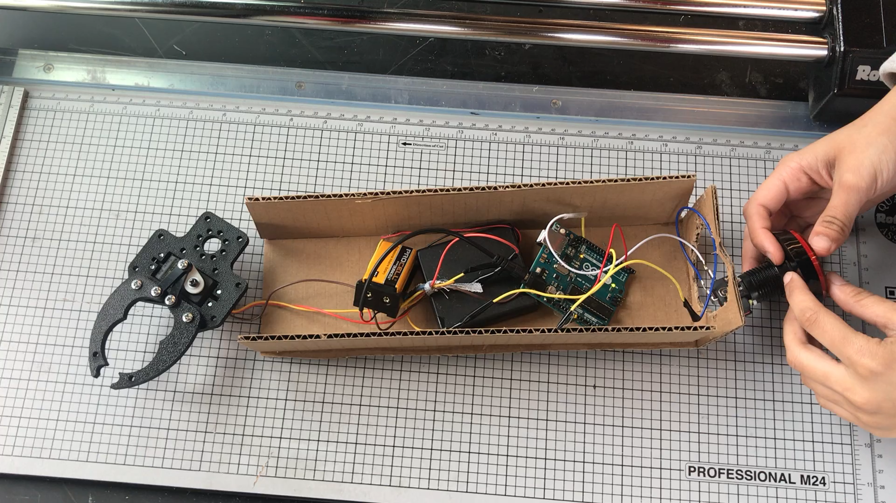
Programmed the gripper and the button together, which was a bit challenging
At this stage, I stopped using the breadboard and started using the Arduino uno board directly

Slide 8
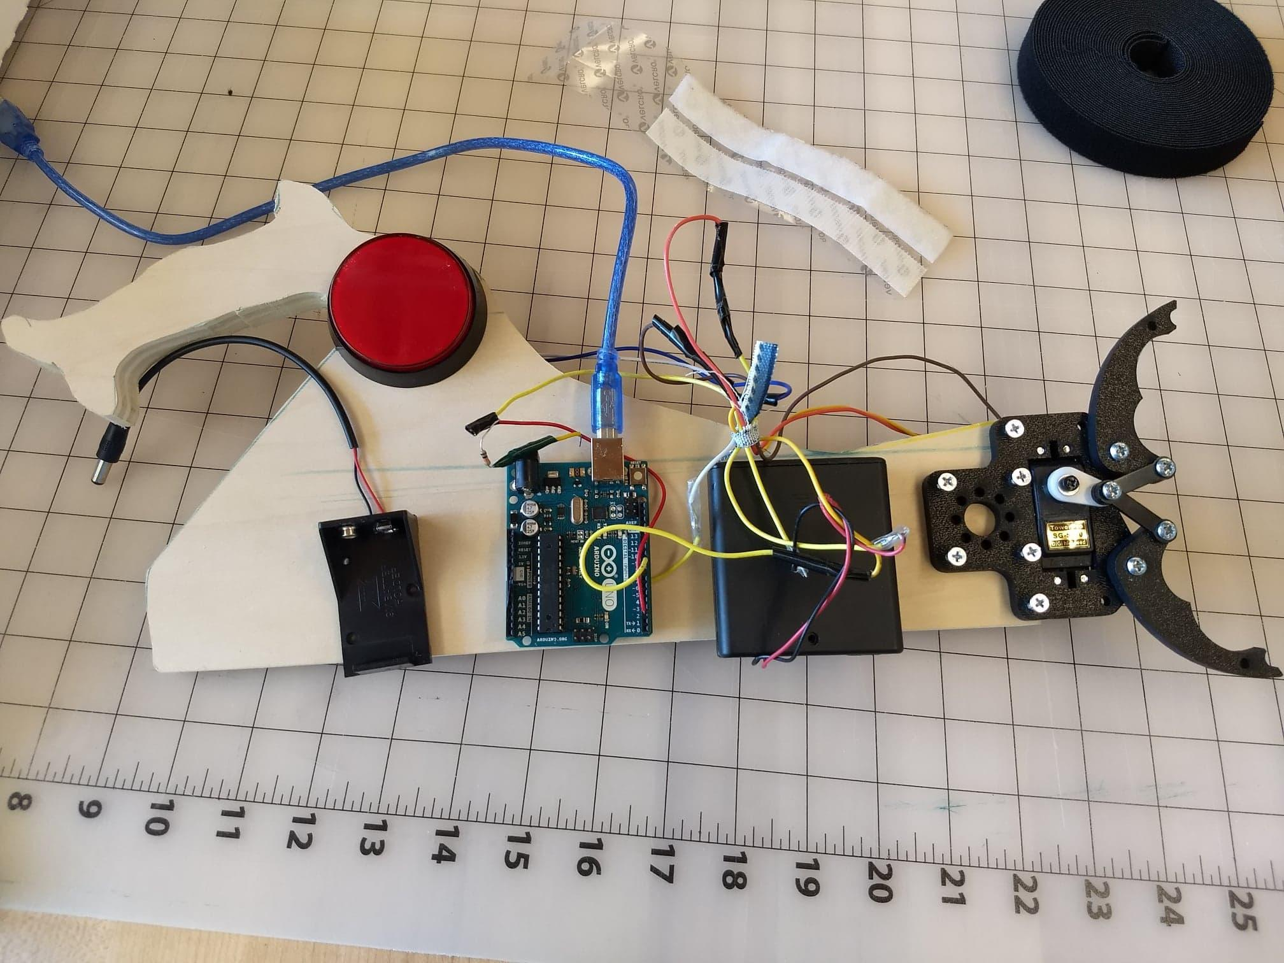
Week 5
Built the arm to hold all the components together.
It was difficult to come up with the design for the arm that would make the device efficient
Used wood and plexiglass to build the arm

Slide 9
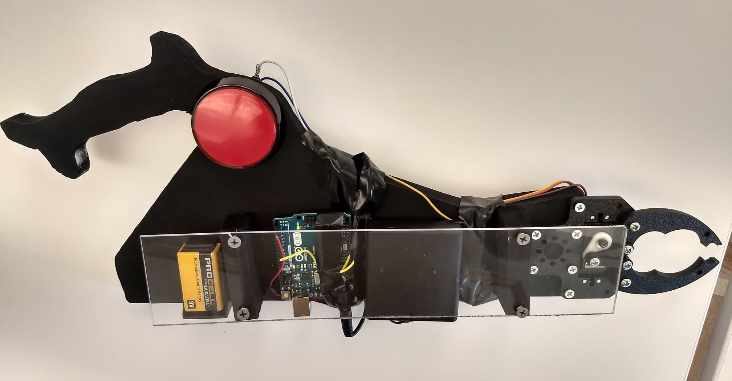
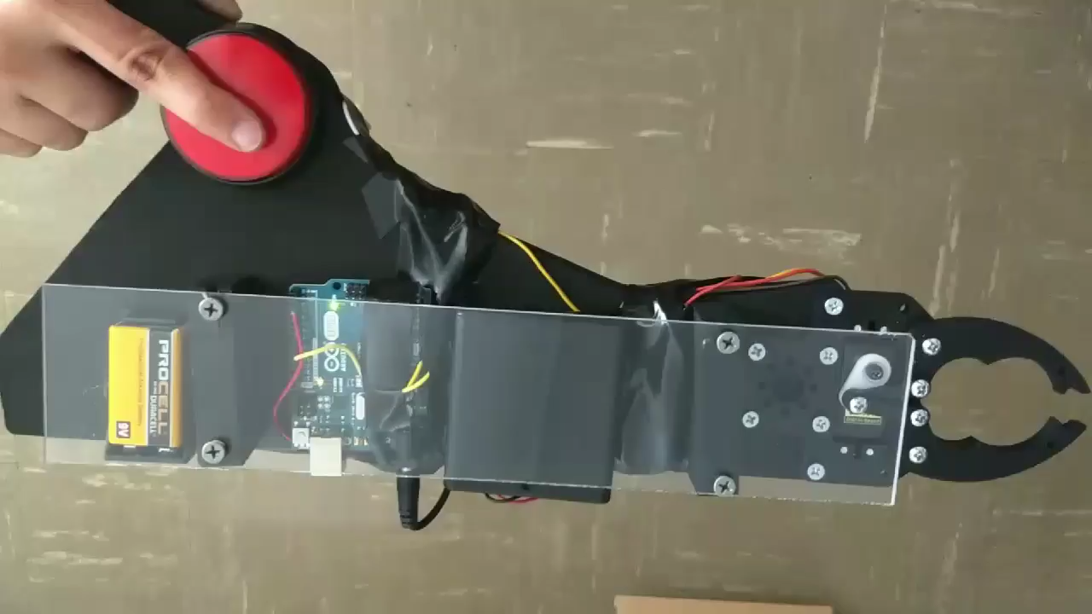
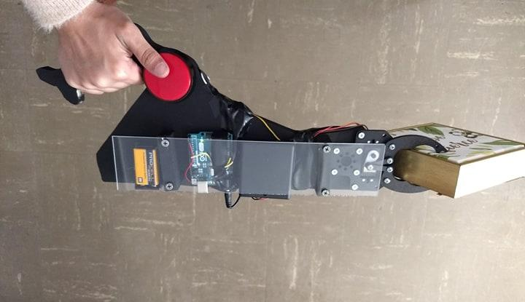
Final product

Slide 10
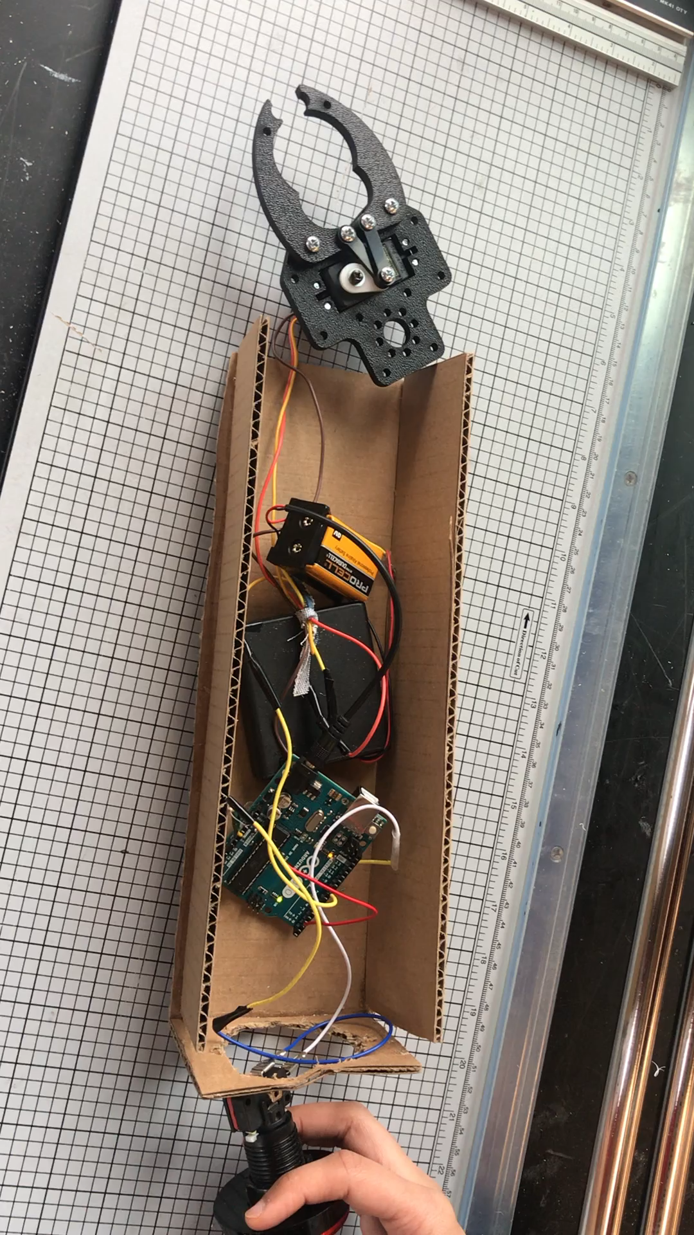
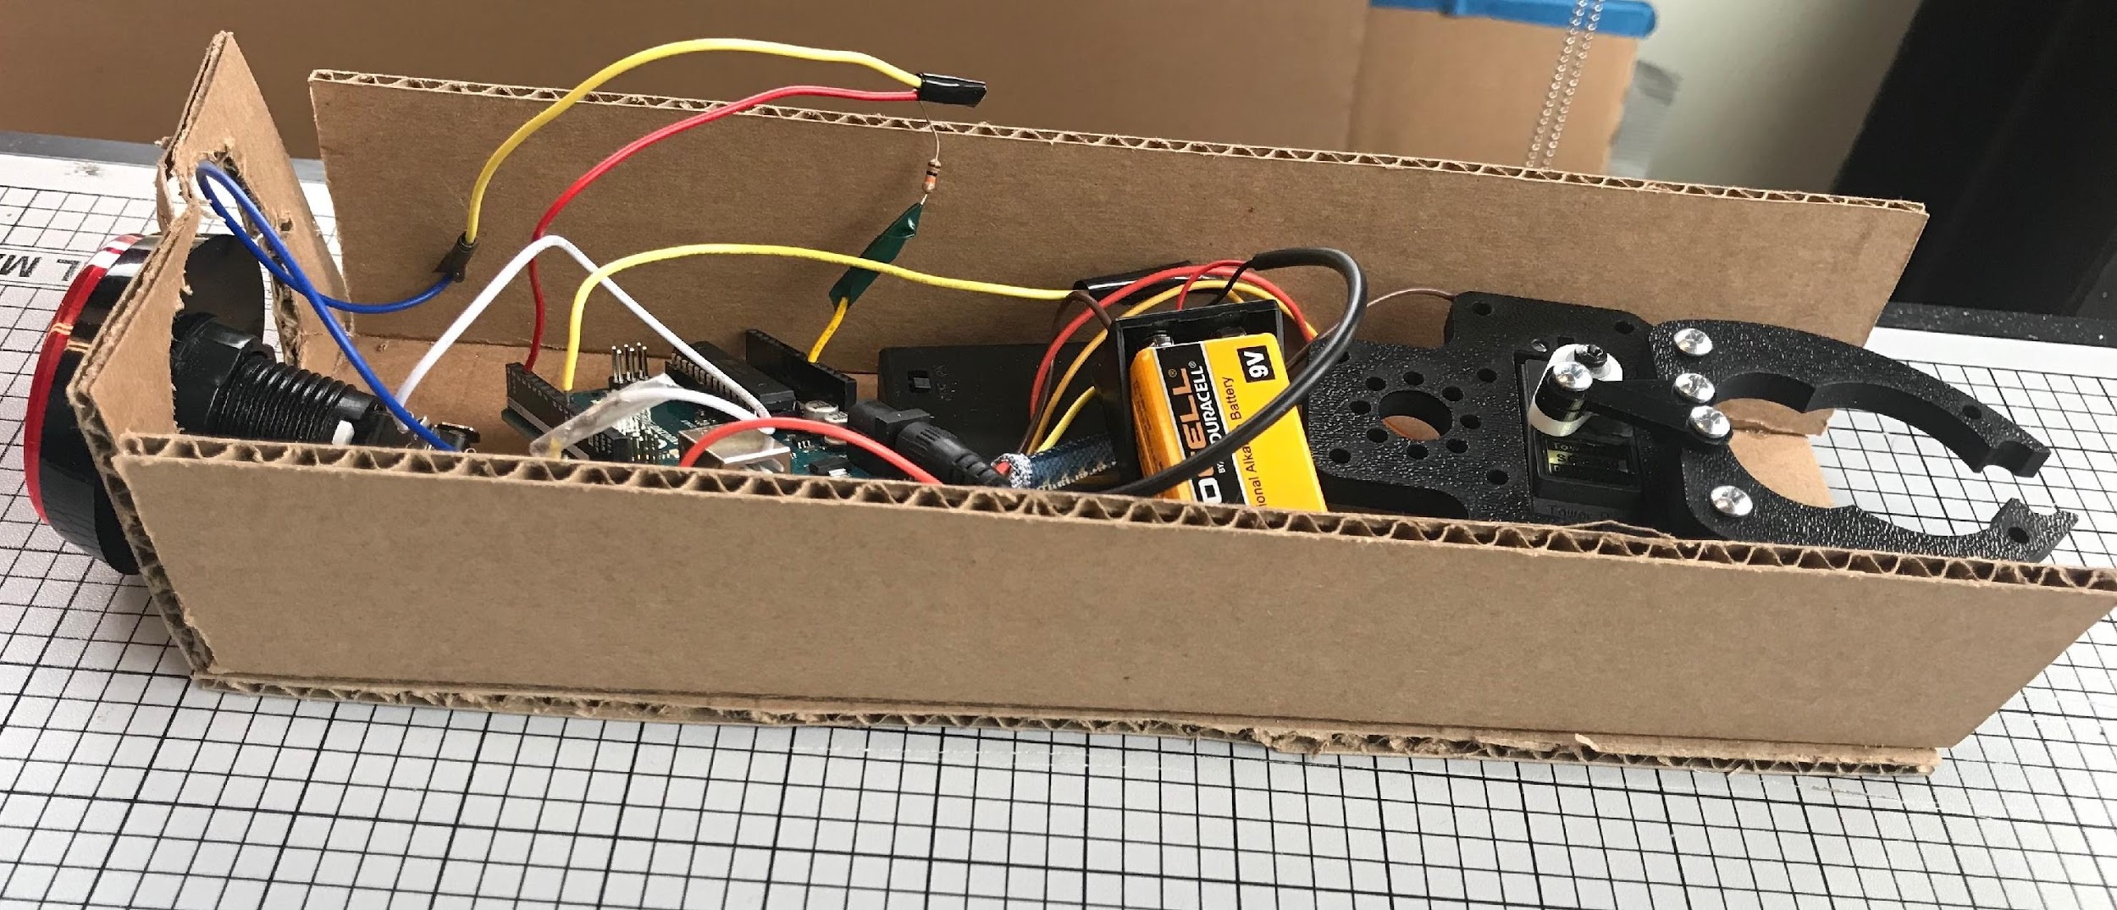
Difficulties
All of the components make it a bit heavy
Making the button and gripper work smoothly was a difficult task but I figured it out
Making a suitable design for the arm took some time

Slide 11
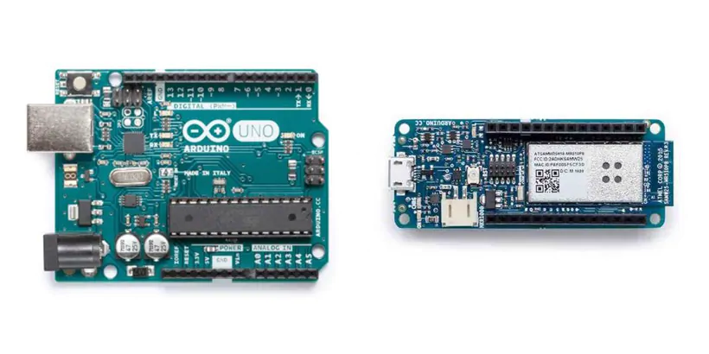
Improvements for future models
Smaller replacements for the big components
They would be lighter so the device could be handled with more ease
The design of the arm could be made sturdier, for example a thicker handle for better support
Claws of the gripper do not fully close so small objects such as a pencil cannot be picked up

